Slide 1

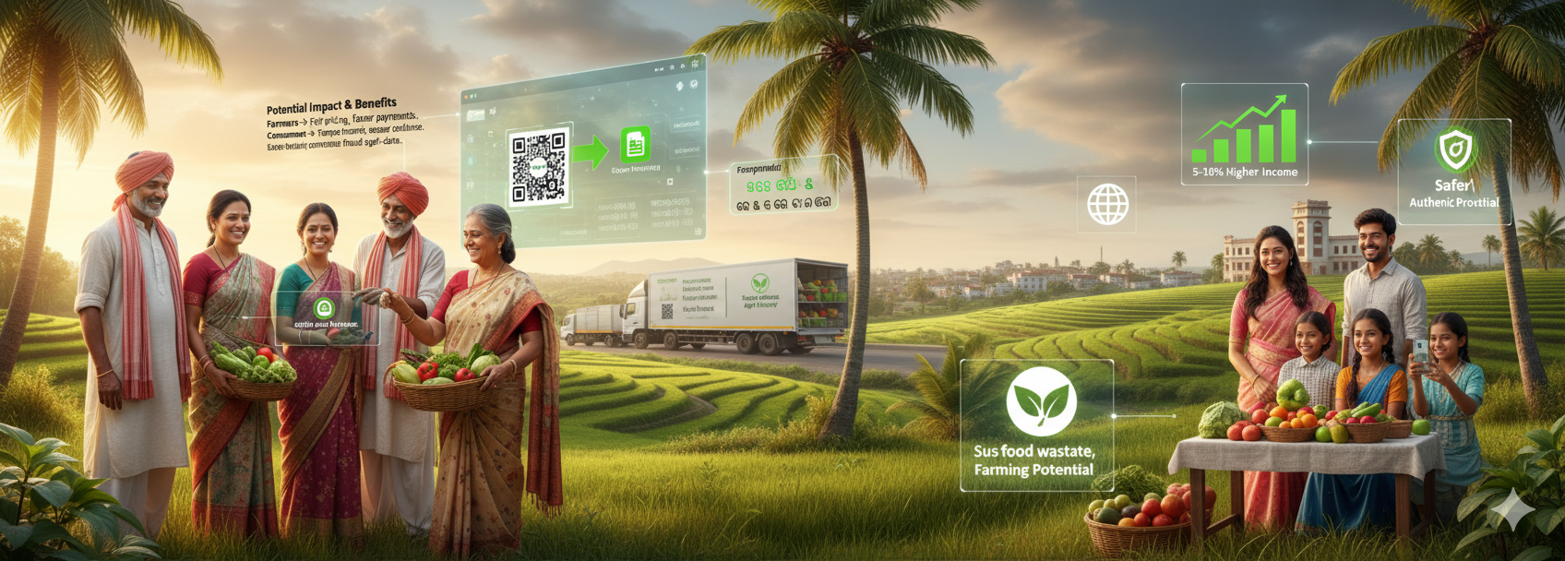
Blockchain-Based Supply Chain Transparency for Agricultural Produce
NFSU ‘25
Description Create a blockchain-based system to track agricultural produce from farm to consumer, ensuring transparency in pricing, quality, and origin. The solution should allow stakeholders (farmers, distributors, retailers) to verify transactions and reduce exploitation in the supply chain. Expected Outcome A decentralized platform with a user-friendly interface for farmers and consumers to trace produce, reducing fraud and ensuring fair pricing, deployable on low-cost hardware or cloud infrastructure. Technical Feasibility Leverages existing blockchain frameworks like Ethereum or Hyperledger, with smart contracts for automated tracking and QR code integration for consumer access.
Problem Statement Title : Blockchain-Based Supply Chain Transparency for Agricultural Produce
Organization : Government of Goa
Category : Software
Problem Statement Number : 25045
Development Team Name : TRACEAGRI
@SIH Idea

Slide 2
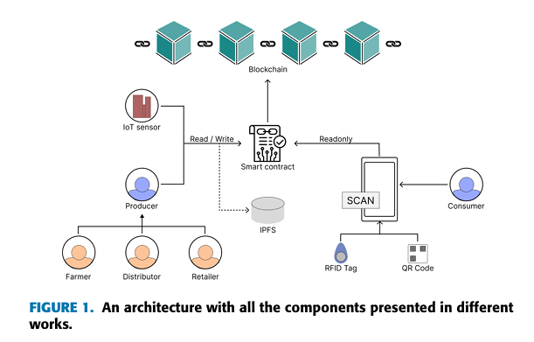
PROPOSED SOLUTION
Web application with two portals – one for farmers/distributors/retailers and one for consumers.
Smart contracts (Ethereum/Polygon) ensure tamper-proof lifecycle tracking with role-based access.
Off-chain storage (IPFS/Cloud) for large/sensitive data; hash references stored on-chain.
Each produce batch has a QR code, which consumers can scan on the web portal to see full verified history.
INNOVATION & UNIQUENESS
End-to-end blockchain traceability of produce (farm → consumer), ensuring tamper-proof records.
Role-based smart contracts give each stakeholder controlled access, preventing unauthorized updates.
QR-code integration lets consumers instantly verify origin, quality, and lifecycle.
Hybrid on-chain + off-chain design (IPFS/Cloud) reduces c6ost while preserving integrity.
Farmer-centric and low-cost solution using Polygon (L2) for affordable deployment.
Transparent consumer web portal directly connected to blockchain, removing intermediaries.
@SIH Idea

Slide 3
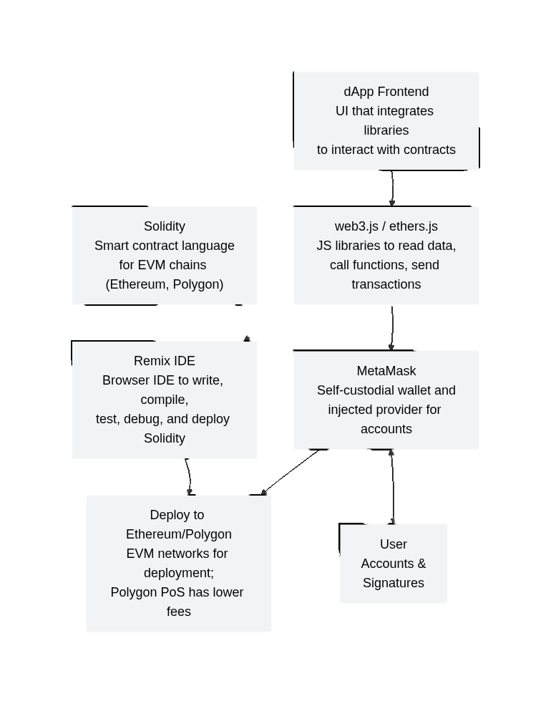
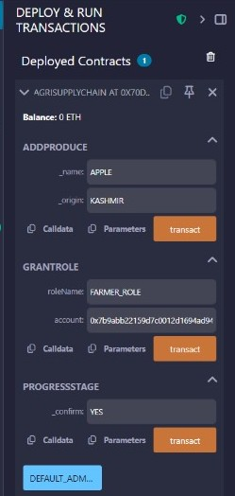
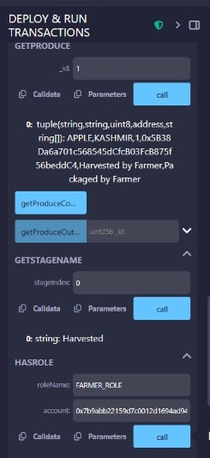
@SIH Idea

Slide 4
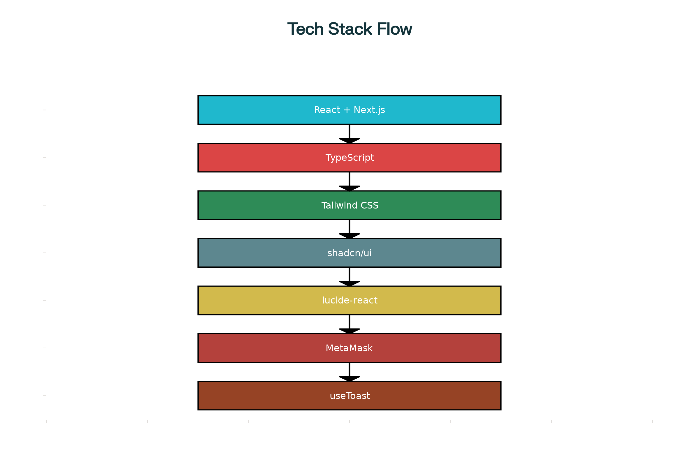
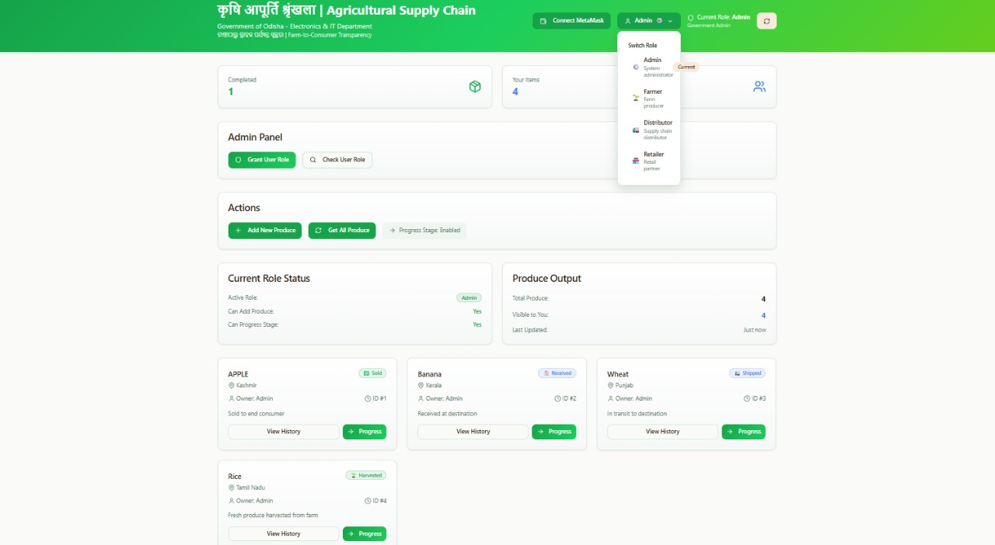
@SIH Idea

Slide 5
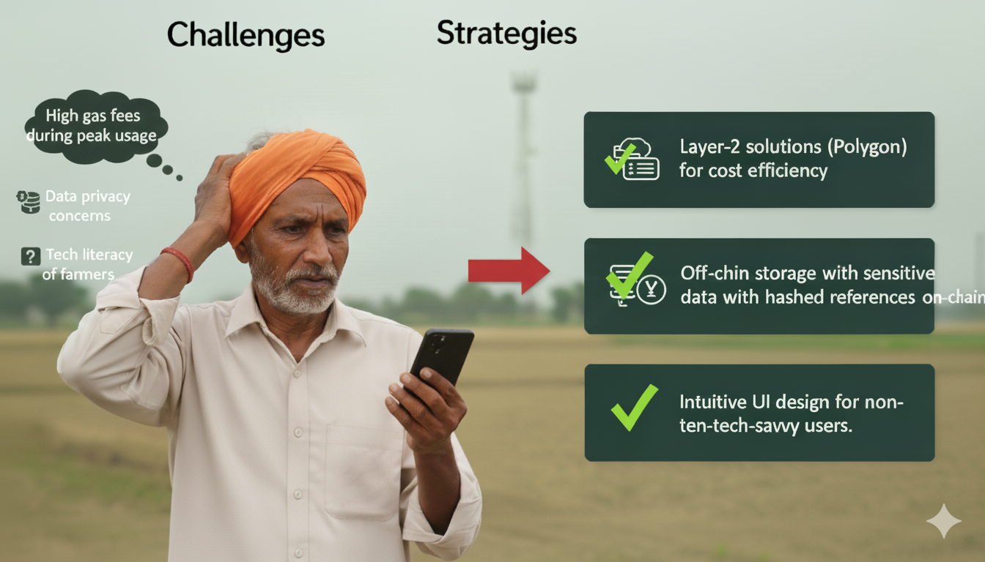

Feasibility
Challenges
Strategies
✓ High Readiness: 96% mobile
coverage + 64% smartphone ownership ✓ Policy Support: Samrudhi, Ama Krushi, Farmer ID provide foundation ✓ Economic Viable: 5-10% price gain outweighs system costs ✓ Clear Adoption Path: Start with FPO pilots, integrate existing platforms
• Layer-2 solutions (Polygon) for cost efficiency.
• Off-chain storage of sensitive data with hashed references on-chain.
• Intuitive UI design for non-tech-savvy users.
• High gas fees during peak usage.
• Data privacy concerns.
• Tech literacy of farmers.
Impact & Benefits
Stakeholder Gains:
Farmers: Better prices, instant payments
Supply Chain: Trusted records, compliance ease
Consumers: Food transparency, safety assurance
Key Advantages:
Economic: 5-10% income boost, export growth
Social: Farmer empowerment, rural inclusion
Environmental: Reduced waste, sustainable practices
@SIH Idea

Slide 6
Research and Referance work:
Research Papers:
1.Blockchain Technology to Support Agri-Food Supply Chains: A Comprehensive Review-IEEE ACCESS
2. Blockchain-driven Agricultural Product Traceability and Supply Chain Management-IEEE ACCESS
GIT repos references:
https://github.com/kerala-blockchain-academy/AgroChain
https://github.com/anotherwebguy/Agri-SupplyChain
https://github.com/ac12644/Supply-Chain-Smart-Contract
@SIH Idea

